Slide 1
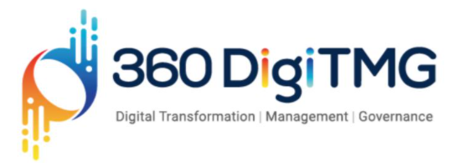

Feature Extraction from Medical Journals

Slide 2
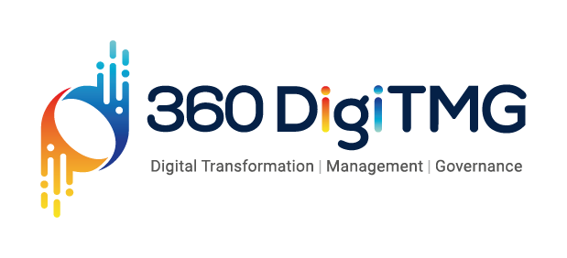
Rahbar Anwar
B.Tech
LinkedIn URL – https://www.linkedin.com/in/rahbar-anwar04902593/

Slide 3


Project Goals
Objectives
Constraints
Maximize the number of named entities to be extract from the data.
Maximize the accuracy of the extracted entities.
Minimize the error in selecting the named entity and time required.
Recognizing the medical terms accurately is a difficult task.

Slide 4
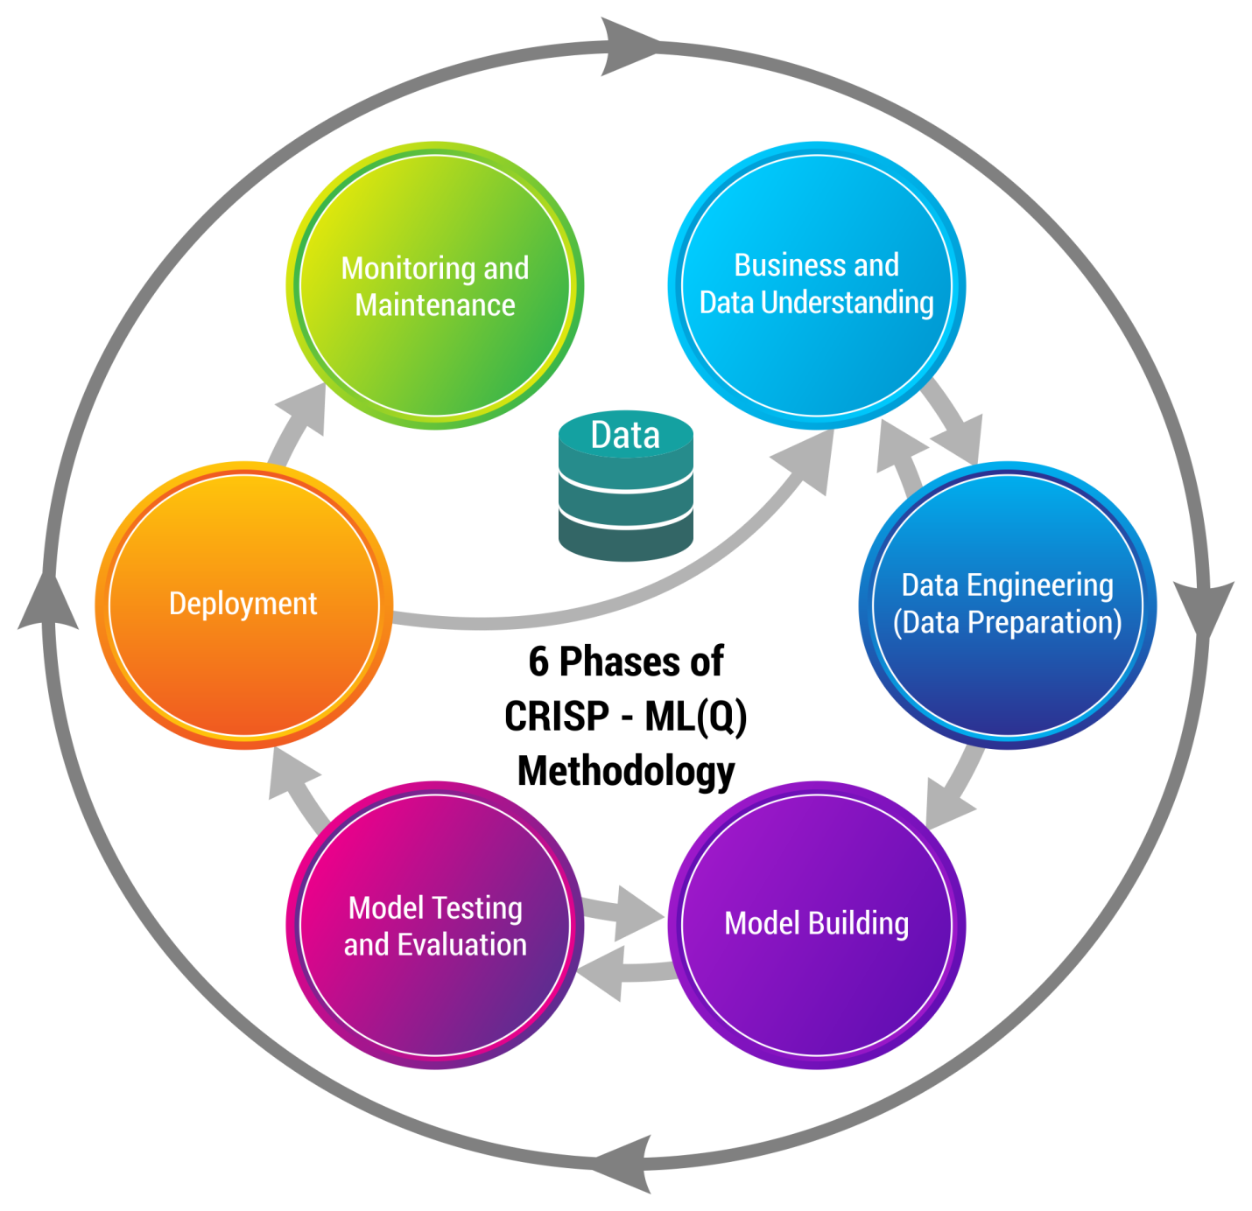
Business pipeline: CRISP-ML(Q) Methodology

Slide 5

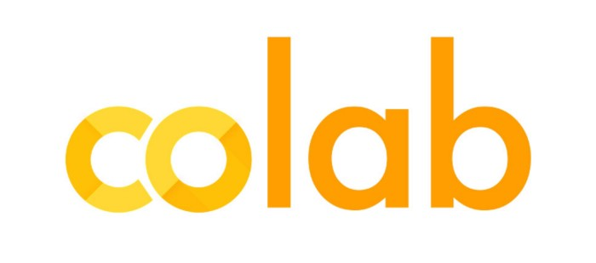
Technical Stacks
List out all the Software, tools and environments used by you.
https://www.frontiersin.org/articles/10.3389/fcell.2020.00673/full
https://analyticsindiamag.com/guide-to-named-entity-recognition-with-spacy-and-nltk/

Slide 6
Project Scope
The main objective of the project is to extract the maximum feature from the medical journals. This will help a lot in medical field to understand different types of situation occurs with different people as well as about the different types of disease and their cure.
This will also help in understanding the possibility of having a particular type of disease or the occurrence ratio.
6

Slide 7
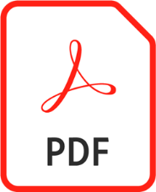

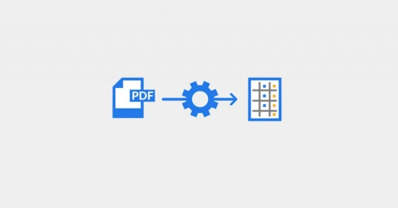

Architecture
Medical Journals
PDF Files
Data Collection
&
Data Understanding
Data Extraction
Or
Named entity recognition
Deployment
NLP Model Building
7

Slide 8

Data Understanding
Data used for training the model is genuine best known to our knowledge and available in the form of pdf..
Data contains the different types of named entity such as person names, university name, medicine names etc. which we have to extract.
This can be done through NLP by using NLTK or spaCy library.

Slide 9
Model Description
Libraries Used:
PyPdf2
Pdfminer
Spacy
En-core-med7-lg
Description:
PyPdf2 is used to merge all the medical journals
Pdfminer is used to extract text from the pdf files.
Spacy is used to build NLP model to extract features .
En-core-med7-lg is used to extract specifically medical entities.

Slide 10
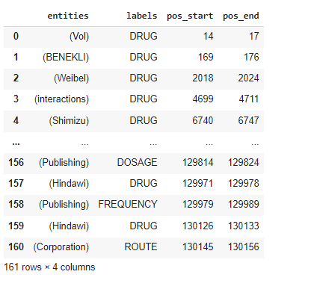
Output

Slide 11


